Slide 1


Android Testing with Robolectric
王峻毅
软件工程师，Robolectric co-maintainer
Beijing

Slide 2
Agenda
Testing Pyramid
Android Testing with Robolectric
sharedTest pattern
Open source projects use Robolectric

Slide 3
Testing Pyramid

Slide 4
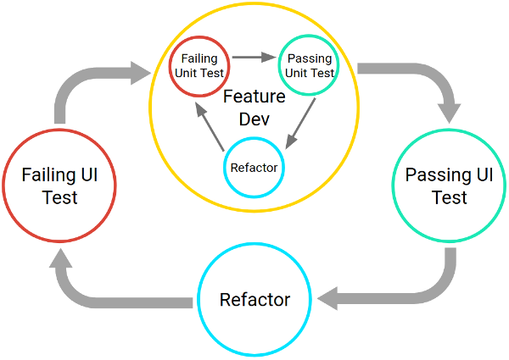
Testing Pyramid
The two cycles associated with iterative, test-driven development

Slide 5

Testing Pyramid
TEST-DRIVEN DEVELOPMENT BY EXAMPLE
KENT BECK

Slide 6

Testing Pyramid
Android Test-Driven Development by Tutorials (Second Edition): Learn Android TDD by Building Real-World Apps
raywenderlich Tutorial Team

Slide 7
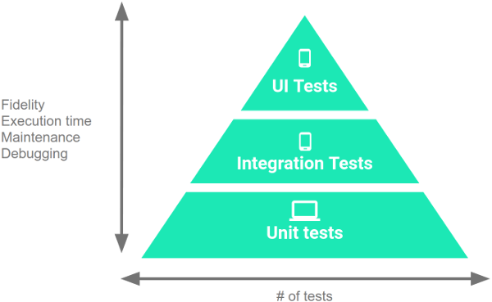
Testing Pyramid
The Testing Pyramid

Slide 8
Testing Pyramid
Large tests are end-to-end tests(10%).
Medium tests are integration tests(20%).
Small tests are unit tests(70%).

Slide 9
Testing Pyramid
UI tests: androidx.test & Espresso
Integration tests: androidx.test & Espresso/Robolectric
Unit tests: Mockito/Mockk/PowerMock/Robolectric

Slide 10
Android Testing with Robolectric

Slide 11

https://github.com/robolectric/robolectric

Slide 12
Why Robolectric?

Slide 13
Why Robolectric?
Performance
Robolectric tests run on the JVM. This avoids all of the overhead with emulators, such as startup time, APK dexing + packaging + copying + installing.

Slide 14
Why Robolectric?
Performance
Robolectric tests run on the JVM. This avoids all of the overhead with emulators, such as startup time, APK dexing + packaging + copying + installing.
2. Flakiness
Tests on emulators have more concurrent threads, leading to nondeterminism and flakiness.

Slide 15
Why Robolectric?
Performance
Robolectric tests run on the JVM. This avoids all of the overhead with emulators, such as startup time, APK dexing + packaging + copying + installing.
2. Flakiness
Tests on emulators have more concurrent threads, leading to nondeterminism and flakiness.
3. APIs
Robolectric offers lots of powerful and extensible testing APIs (Shadow APIs) not available in emulators.

Slide 16









Why Robolectric?
Selected by industry leading tech companies:
Notes:
Google Meta/Facebook Microsoft Slack Twitter Lyft Squre Spotify VMware-tanzu/Pivotal Labs

Slide 17
How to integrate Robolectric?

Slide 18
Integrate Robolectric
android {
testOptions {
unitTests.includeAndroidResources = true
}
}
dependencies {
testImplementation 'junit:junit:4.13.2'
testImplementation 'androidx.test:monitor:1.4.0'
testImplementation 'androidx.test:runner:1.4.0'
testImplementation 'androidx.test:rules:1.4.0'
testImplementation 'androidx.test.ext:junit:1.1.3'
testImplementation 'androidx.test.ext:junit-ktx:1.1.3'
testImplementation 'androidx.test.ext:truth:1.4.0'
testImplementation 'androidx.test:core:1.4.0'
testImplementation 'com.google.truth:truth:1.1.3'
testImplementation 'org.robolectric:robolectric:4.7.3'
}

Slide 19
Integrate Robolectric
@RunWith(RobolectricTestRunner::class)
class MainActivityRobolectricTest {
@Test
fun `click hint button and hint view should update content with text Hint`() {
ActivityScenario.launch(MainActivity::class.java).use { scenario ->
scenario.onActivity { activity: MainActivity ->
val button = activity.findViewById<Button>(R.id.btn_show_hint)
button.performClick()
val tvHint = activity.findViewById<TextView>(R.id.tv_hint)
assertThat(tvHint.text).isEqualTo("Hint")
}
}
}
}

Slide 20
Core features

Slide 21
Core feature - Real Resources
android {
testOptions {
unitTests.includeAndroidResources = true
}
}
Notes:
Speed, Speed, Speed

Slide 22
Core feature - Real Resources
@Test
fun clickHintButton_hintViewShouldShowTextHint() {
rule.scenario.use { scenario: ActivityScenario<MainActivity> ->
scenario.onActivity { activity: MainActivity ->
val button = activity.findViewById<Button>(R.id.btn_show_hint)
button.performClick()
val tvHint = activity.findViewById<TextView>(R.id.tv_hint)
assertThat(tvHint.text).isEqualTo(MainActivity.HINT_HINT)
}
}
}

Slide 23
Core feature - Configure SDK
Cross Android SDKs : 16 - 31

Slide 24
Core feature - Configure SDK
@Config(minSdk = N, maxSdk = N_MR1)
@Test
fun `old multi window mode changed and hint view should update content with text old-multi-window`() {
rule.scenario.use { scenario: ActivityScenario<MainActivity> ->
scenario.onActivity { activity: MainActivity ->
// Deprecated from SDK 26
activity.onMultiWindowModeChanged(true)
val tvHint = activity.findViewById<TextView>(R.id.tv_hint)
assertThat(tvHint.text).isEqualTo(MainActivity.HINT_OLD_MULTI_WINDOW)
}
}
}

Slide 25
Core feature - Configure SDK
@Config(minSdk = O)
@Test
fun `multi window mode changed and hint view should update content with text multi-window`() {
rule.scenario.use { scenario: ActivityScenario<MainActivity> ->
scenario.onActivity { activity: MainActivity ->
activity.onMultiWindowModeChanged(true, activity.resources.configuration)
val tvHint = activity.findViewById<TextView>(R.id.tv_hint)
assertThat(tvHint.text).isEqualTo(MainActivity.HINT_MULTI_WINDOW)
}
}
}

Slide 26
Core feature - Configure Qualifiers
Cross Android devices
https://developer.android.com/guide/topics/resources/providing-resources.html#QualifierRules

Slide 27
Core feature - Configure Qualifiers
// https://developer.android.com/guide/topics/resources/providing-resources.html#QualifierRules
@Config(qualifiers = "port")
@Test
fun `orientation hint view should show normal for portrait layout`() {
rule.scenario.use { scenario: ActivityScenario<MainActivity> ->
scenario.onActivity { activity: MainActivity ->
val tvHintOrientation = activity.findViewById<TextView>(R.id.tv_hint_orientation);
assertThat(tvHintOrientation.text).isEqualTo(
activity.resources.getString(R.string.hint_orientation_normal)
)
}
}
}

Slide 28
Core feature - Configure Qualifiers
// https://developer.android.com/guide/topics/resources/providing-resources.html#QualifierRules
@Config(qualifiers = "land")
@Test
fun `orientation hint view should show landscape for landscape layout`() {
rule.scenario.use { scenario: ActivityScenario<MainActivity> ->
scenario.onActivity { activity: MainActivity ->
val tvHintOrientation = activity.findViewById<TextView>(R.id.tv_hint_orientation);
assertThat(tvHintOrientation.text).isEqualTo(
activity.resources.getString(R.string.hint_orientation_landscape)
)
}
}
}

Slide 29
Core feature - Configure Display
Changing display when testing

Slide 30
Core feature - Configure Display
private void setExpectedDisplayRotation(int rotation) {
ShadowDisplay display =
Shadows.shadowOf(
((WindowManager)
RuntimeEnvironment.systemContext.getSystemService(Context.WINDOW_SERVICE))
.getDefaultDisplay());
display.setRotation(rotation);
}

Slide 31
Core feature - Shadow
Simulated Android frameworks on JVM

Slide 32
Core feature - Shadow
Why “Shadow”?
Shadow objects are not quite Proxies, not quite Fakes, not quite Mocks or Stubs.
Shadows are sometimes hidden, sometimes seen, and can lead you to the real object.

Slide 33
Core feature - Shadow
public class ShowHideTaskbarReceiver extends BroadcastReceiver {
@Override
public void onReceive(Context context, Intent intent) {
if (intent == null || !ACTION_SHOW_HIDE_TASKBAR.equals(intent.getAction())) {
return;
}
// some checks
Intent notificationIntent = new Intent(context, NotificationService.class);
// some checks
U.startForegroundService(context, notificationIntent);
}
}

Slide 34
Core feature - Shadow
@Test
fun `show hidden Taskbar when receiving ACTION_SHOW_HIDE_TASKBAR`() {
val intent = Intent(Constants.ACTION_SHOW_HIDE_TASKBAR)
// Seen things of Shadow.
ShadowSettings.setCanDrawOverlays(true)
Shadows.shadowOf(application).clearStartedServices()
// onReceive will start/notify notification service to show Taskbar.
// Robolectric will start service for it.
// hidden thing of Shadow.
showHideTaskbarReceiver.onReceive(context, intent)
// Robolectric will store started service component for testing.
// Another seen thing of Shadow.
val startedServiceIntent = Shadows.shadowOf(application).peekNextStartedService()
Assert.assertNotNull(startedServiceIntent)
Assert.assertEquals(notificationIntent.component, startedServiceIntent.component)
}

Slide 35
Core feature - Shadow
Hidden for core services on JVM
Seen for helper things to get/set state
http://robolectric.org/javadoc/4.7/

Slide 36


Core feature - Multi Build System

Slide 37
Core feature - Multi Build System
http_archive(
name = "robolectric",
urls = ["https://github.com/robolectric/robolectric-bazel/archive/4.7.3.tar.gz"],
strip_prefix = "robolectric-bazel-4.7.3",
)
load("@robolectric//bazel:robolectric.bzl", "robolectric_repositories")
robolectric_repositories()

Slide 38
Core feature - Multi Build System
http_archive(
name = "rules_jvm_external",
strip_prefix = "rules_jvm_external-4.1",
sha256 = "f36441aa876c4f6427bfb2d1f2d723b48e9d930b62662bf723ddfb8fc80f0140",
url = "https://github.com/bazelbuild/rules_jvm_external/archive/4.1.zip",
)
load("@rules_jvm_external//:defs.bzl", "maven_install")
maven_install(
artifacts = [
"org.robolectric:robolectric:4.7.3",
],
repositories = [
"https://maven.google.com",
"https://repo1.maven.org/maven2",
],
)

Slide 39
Core feature - Multi Build System
android_local_test(
name = "greeter_activity_test",
srcs = ["GreeterTest.java"],
manifest = "TestManifest.xml",
test_class = "com.example.bazel.GreeterTest",
deps = [
":greeter_activity",
"@maven//:org_robolectric_robolectric",
"@robolectric//bazel:android-all",
],
)

Slide 40
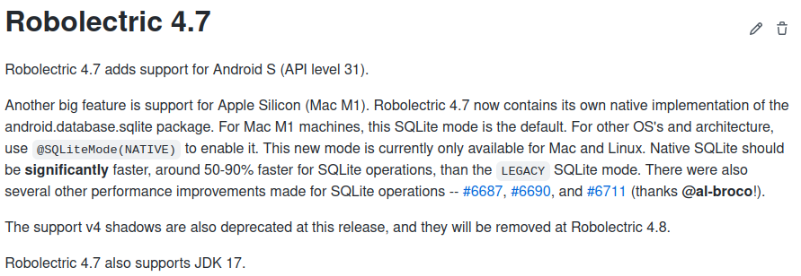
Core feature - M1 Supporting

Slide 41
sharedTest pattern

Slide 42
sharedTest
“Write Once,Run Everywhere Tests on Android.”
-- Jonathan Gerrish

Slide 43
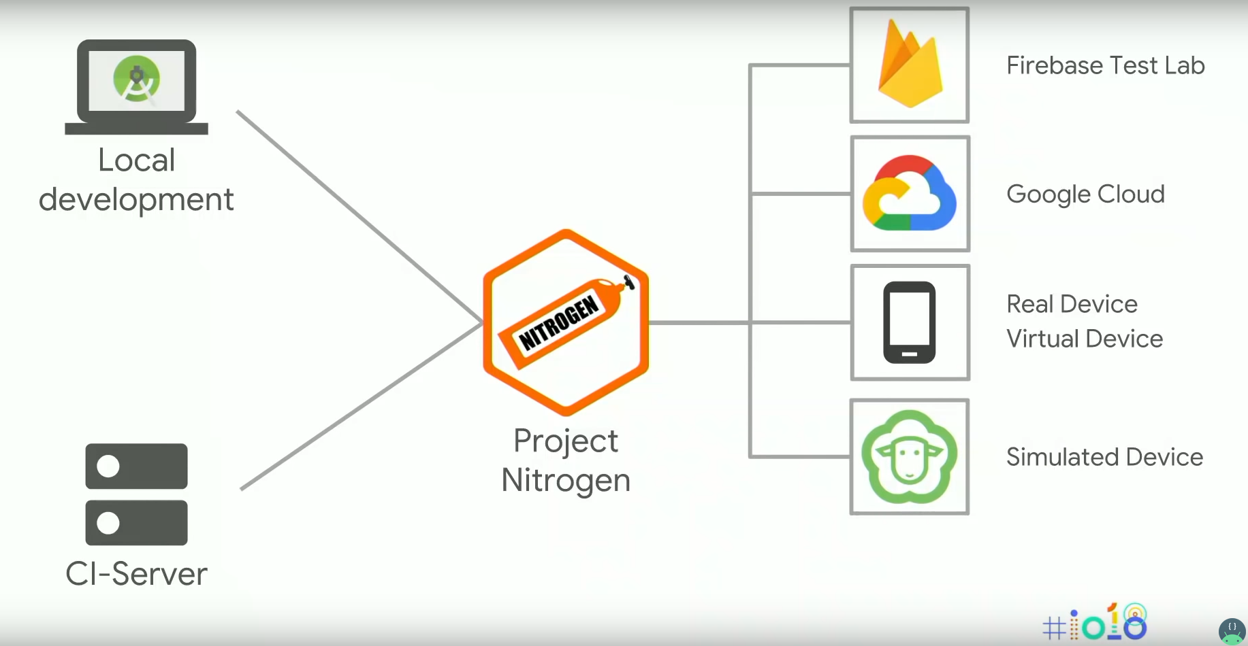

Slide 44
sharedTest - AndroidJUnit4
@RunWith(AndroidJUnit4::class)
class MainActivityCommonTest {
@Test
fun clickHintButton_hintViewShouldShowTextHint() {
ActivityScenario.launch(MainActivity::class.java).use { scenario ->
scenario.onActivity { activity: MainActivity ->
val button = activity.findViewById<Button>(R.id.btn_show_hint)
button.performClick()
val tvHint = activity.findViewById<TextView>(R.id.tv_hint)
assertThat(tvHint.text).isEqualTo("Hint")
}
}
}
}

Slide 45
sharedTest - Structure
├── androidTest
│ └── java
│ └── demo
│ └── ExampleInstrumentedTest.kt
├── sharedTest
│ └── java
│ └── demo
│ └── MainActivityCommonTest.kt
└── test
└── java
└── demo
└── MainActivityRobolectricTest.kt
sourceSets {
String sharedTestDir = 'src/sharedTest/'
String sharedTestSourceDir = sharedTestDir + 'java'
String sharedTestResourceDir = sharedTestDir + 'resources'
test.resources.srcDirs += sharedTestResourceDir
test.java.srcDirs += sharedTestSourceDir
androidTest.resources.srcDirs += sharedTestResourceDir
androidTest.java.srcDirs += sharedTestSourceDir
}

Slide 46
sharedTest - GMD + ATD images
import com.android.build.api.dsl.ManagedVirtualDevice
testOptions {
unitTests.includeAndroidResources = true
devices {
// ./gradlew -Pandroid.sdk.channel=3 nexusOneApi30DebugAndroidTest
nexusOneApi30(ManagedVirtualDevice) {
device = "Nexus One"
apiLevel = 30
systemImageSource = "aosp-atd"
abi = "x86"
}
}
}
ATD: Automated Test Device, slimmer for testing.
GMD: Gradle Managed Device
https://android-developers.googleblog.com/2021/10/whats-new-in-scalable-automated-testing.html

Slide 47
sharedTest - GMD + ATD images
./gradlew test
./gradlew
-Pandroid.sdk.channel=3 nexusOneApi30DebugAndroidTest

Slide 48
sharedTest - Android Studio
Hard on Android Studio!!!
Please star https://issuetracker.google.com/issues/132426298

Slide 49
sharedTest - Article
sharedTest pattern:
sharing tests and speeding up development
http://robolectric.org/blog/2021/10/06/sharedTest/

Slide 50
Open source projects use Robolectric

Slide 51
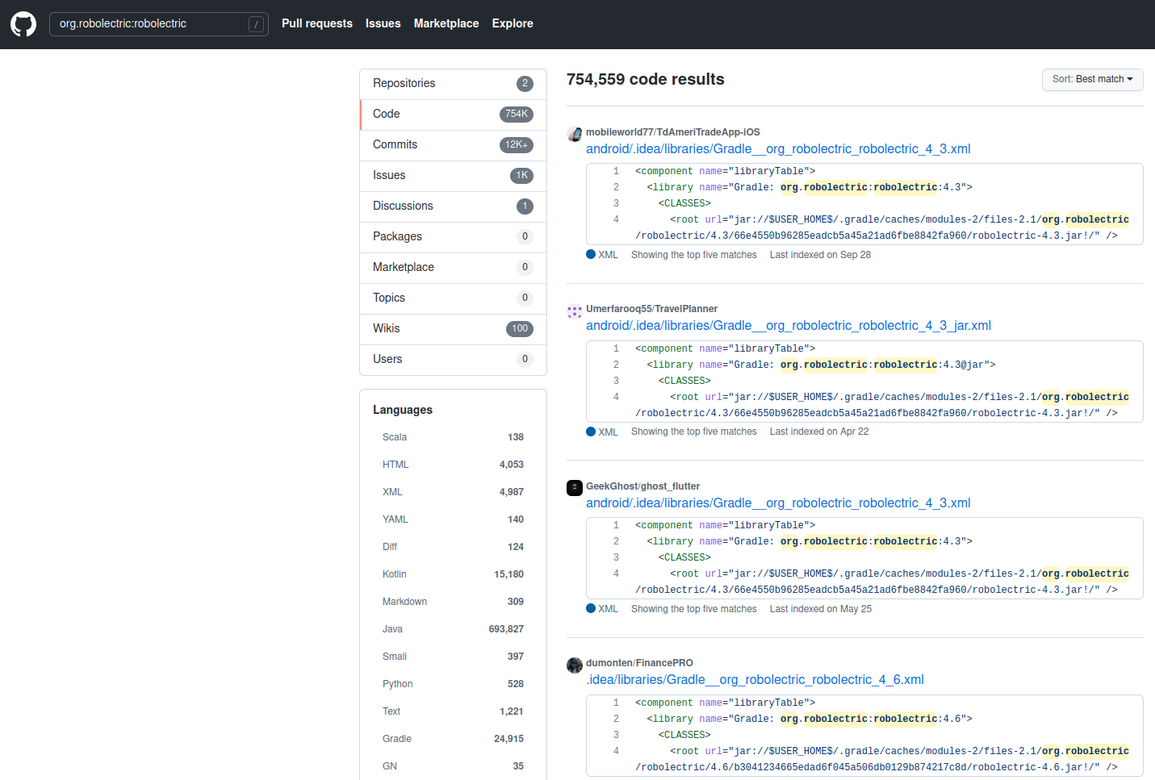
Open source projects uses Robolectric
Code: 754K
Commits: 12K+
Issues: 1K+
Gradle: 24915
Java: 693827
Kotlin: 15180
https://github.com/search?q=org.robolectric%3Arobolectric&type=Code

Slide 52
Flutter uses Robolectric

Slide 53
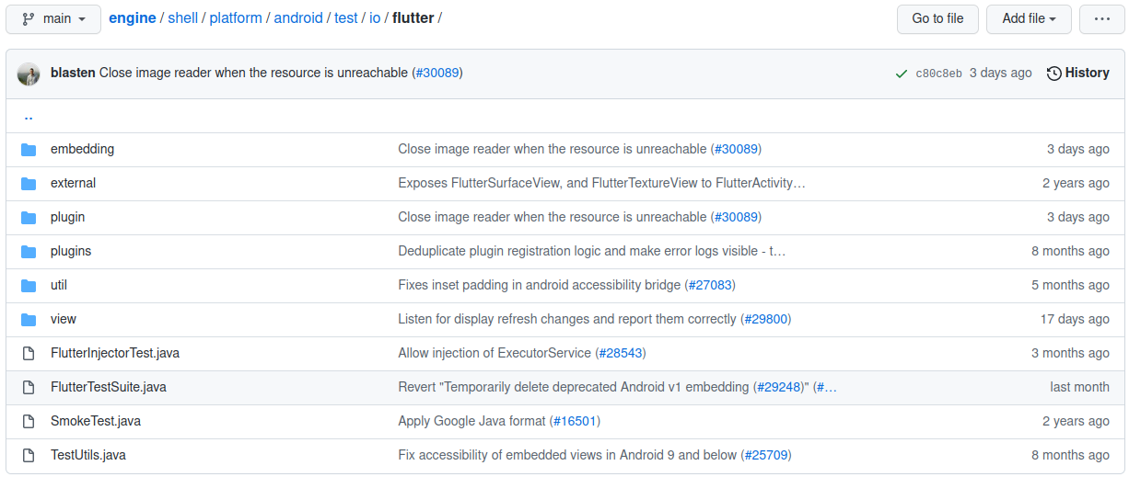
Flutter uses Robolectric

Slide 54
Flutter uses Robolectric
if (orientation == Configuration.ORIENTATION_LANDSCAPE) {
if (rotation == Surface.ROTATION_90) {
return ZeroSides.RIGHT;
} else if (rotation == Surface.ROTATION_270) {
// In android API >= 23, the nav bar always appears on the "bottom" (USB) side.
return Build.VERSION.SDK_INT >= 23 ? ZeroSides.LEFT : ZeroSides.RIGHT;
}
// Ambiguous orientation due to landscape left/right default. Zero both sides.
else if (rotation == Surface.ROTATION_0 || rotation == Surface.ROTATION_180) {
return ZeroSides.BOTH;
}
}

Slide 55
Flutter uses Robolectric
@Test
@Config(minSdk = 20, maxSdk = 22)
public void systemInsetHandlesFullscreenNavbarRightBelowSDK23() {
RuntimeEnvironment.setQualifiers("+land");
FlutterView flutterView = spy(new FlutterView(RuntimeEnvironment.systemContext));
setExpectedDisplayRotation(Surface.ROTATION_270);
// ...
flutterView.onApplyWindowInsets(windowInsets);
// ...
validateViewportMetricPadding(viewportMetricsCaptor, 100, 0, 0, 0);
}

Slide 56
Flutter uses Robolectric
@Test
@Config(minSdk = 23, maxSdk = 29)
public void systemInsetHandlesFullscreenNavbarRight() {
RuntimeEnvironment.setQualifiers("+land");
FlutterView flutterView = spy(new FlutterView(RuntimeEnvironment.systemContext));
setExpectedDisplayRotation(Surface.ROTATION_90);
// ...
flutterView.onApplyWindowInsets(windowInsets);
// ...
validateViewportMetricPadding(viewportMetricsCaptor, 100, 0, 0, 0);
}

Slide 57
AOSP uses Robolectric

Slide 58
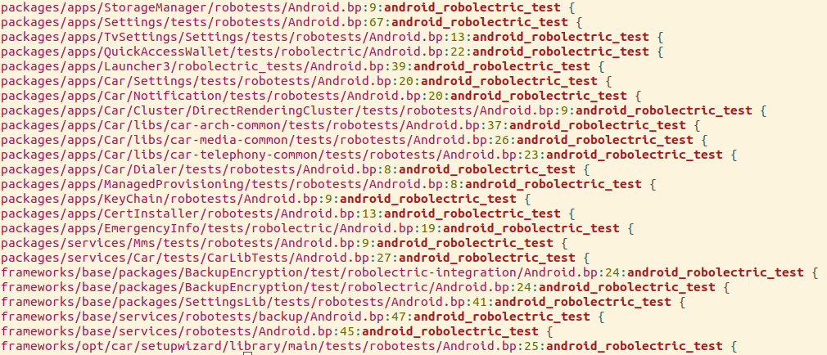
AOSP uses Robolectric
Notes:
Speed, Speed, Speed

Slide 59
AOSP uses Robolectric
packages/apps/Car/Settings/tests/robotests/*/ScreenshotContextPreferenceControllerTest.java
@Test
public void refreshUi_screenshotDisabled_preferenceUnchecked() {
mTwoStatePreference.setChecked(true);
Settings.Secure.putInt(mContext.getContentResolver(),
Settings.Secure.ASSIST_SCREENSHOT_ENABLED, 0);
mController.refreshUi();
assertThat(mTwoStatePreference.isChecked()).isFalse();
}
Notes:
Speed, Speed, Speed

Slide 60
AOSP uses Robolectric
packages/apps/Car/Settings/tests/robotests/*/ErrorDialogTest.java
@Test
public void testOkDismissesDialog() {
ErrorDialog dialog = ErrorDialog.show(mTestFragment, R.string.delete_user_error_title);
assertThat(isDialogShown()).isTrue(); // Dialog is shown.
// Invoke cancel.
DialogTestUtils.clickPositiveButton(dialog);
assertThat(isDialogShown()).isFalse(); // Dialog is dismissed.
}
Notes:
Speed, Speed, Speed

Slide 61
Chromium uses Robolectric

Slide 62
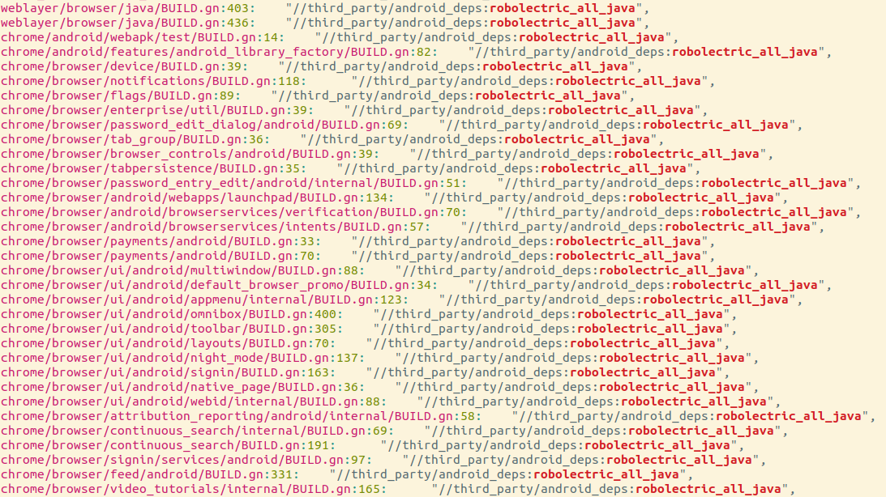
Chromium uses Robolectric
Notes:
Speed, Speed, Speed

Slide 63
Chromium uses Robolectric
WebContentsDarkModeControllerUnitTest.java
/** Shadow class for {@link org.chromium.ui.util.ColorUtils} */
@Implements(ColorUtils.class)
public class ShadowColorUtils {
public static boolean sInNightMode;
@Implementation
public static boolean inNightMode(Context context) {
return sInNightMode;
}
}
Notes:
Speed, Speed, Speed

Slide 64
Chromium uses Robolectric
WebContentsDarkModeControllerUnitTest.java
@Test
public void testFeatureEnabled() {
ShadowColorUtils.sInNightMode = true;
mIsGlobalSettingsEnabled = true;
Assert.assertTrue(
"Feature should be enabled, if both global settings and night mode enabled.",
WebContentsDarkModeController.isFeatureEnabled(mMockContext, mMockProfile));
}
Notes:
Speed, Speed, Speed

Slide 65
Chromium uses Robolectric
WebContentsDarkModeControllerUnitTest.java
@Test
public void testFeatureEnabled_LightMode() {
ShadowColorUtils.sInNightMode = false;
mIsGlobalSettingsEnabled = true;
Assert.assertFalse("Feature should be disabled when not in night mode.",
WebContentsDarkModeController.isFeatureEnabled(mMockContext, mMockProfile));
}
Notes:
Speed, Speed, Speed

Slide 66
Chromium uses Robolectric
WebContentsDarkModeControllerUnitTest.java
@Test
public void testFeatureEnabled_NoUserSettings() {
ShadowColorUtils.sInNightMode = true;
mIsGlobalSettingsEnabled = false;
Assert.assertFalse("Feature should be disabled when global settings disabled.",
WebContentsDarkModeController.isFeatureEnabled(mMockContext, mMockProfile));
}
Notes:
Speed, Speed, Speed

Slide 67
Happy testing

Slide 68
Thanks

